Slide 1
Evolving Global Business Landscape: Implications for Business School Education
Dr. Andrew Spicer
Darla Moore School of Business
University of South Carolina
aspicer@moore.sc.edu

Slide 2

21st Century Global Leadership
Self-Management
Self-Development
Diversity and Cultural Awareness
Ethics and Integrity
Contested World Order
Team
Management
Personal
Leadership
Geopolitical Risk and Opportunity
Effective Communication and Influence
Global
Leadership
Team
Leadership
Geopolitical
Leadership
Global Value Chain Redesign
Development of People
Enterprise
Leadership
Global Agility and Resiliency
Inclusion and Respect
Strategic
Vision
Strategic
Innovation
Systemic Decision-Making
Stakeholder Management

Slide 3
International Business and Global Leadership
Global
Leadership
Core
Knowledge

Slide 4
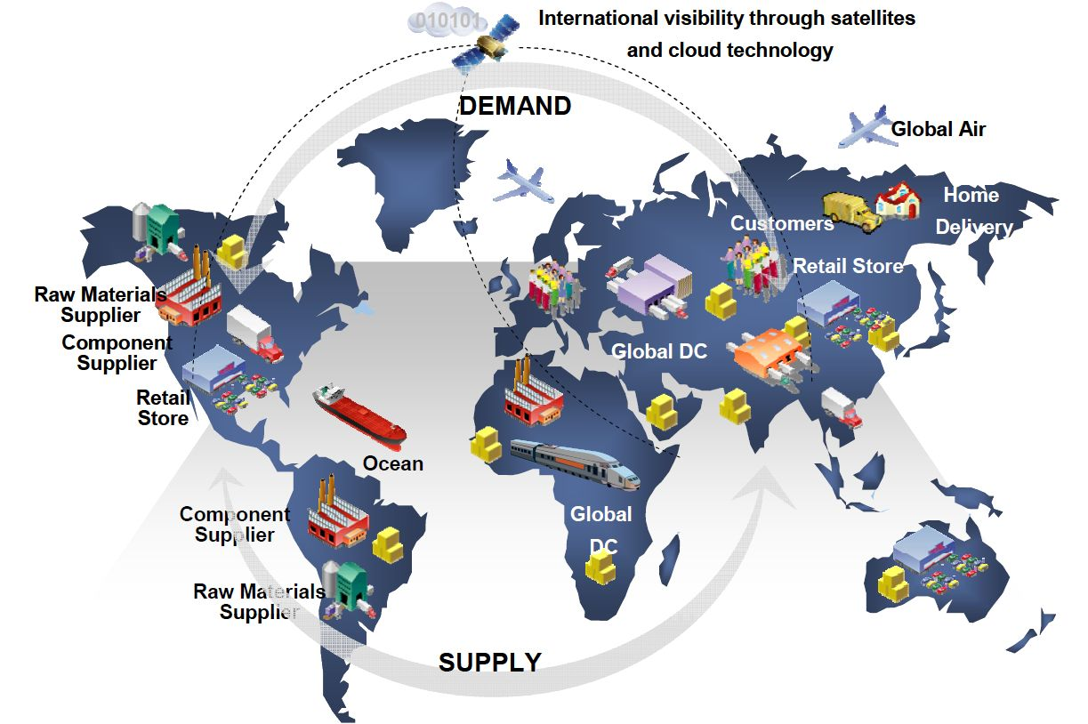
Global Leadership: Connecting Students to the World
Global processes are abstract
  Difficult to “see” or “touch” the global systems in which we live and work
Global processes are distant and distributed
  Difficult to comprehend places, people and perspectives far away from our own everyday reality
Source: https://www.supplychain247.com/article/the_supply_chain_silent_threat_cyber_attack/security

Slide 5
Education Abroad as Global Leadership
Experience-near
Experience-distant
B
Field
Experience
C
A
The broad-view, the view at first encounter.
New, more valid understanding of national locations. New language, stories and strategies to explain to experience-distant audiences. Improved self-awareness.

Slide 6
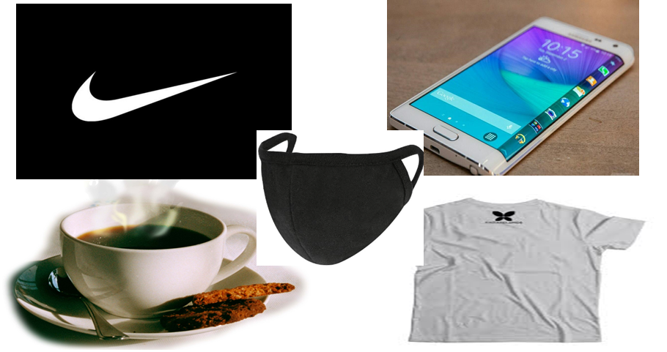
Working Backwards: How are Familiar Products Produced?

Slide 7
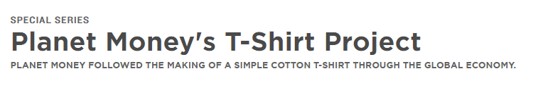
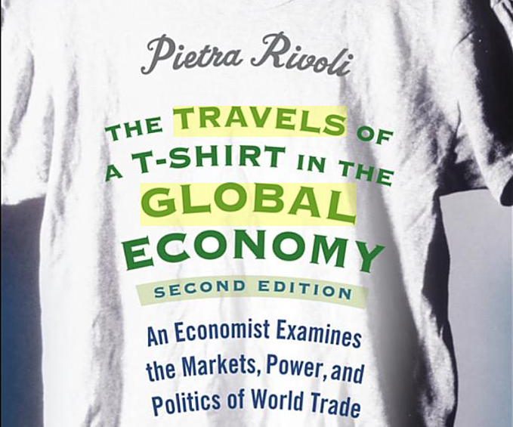
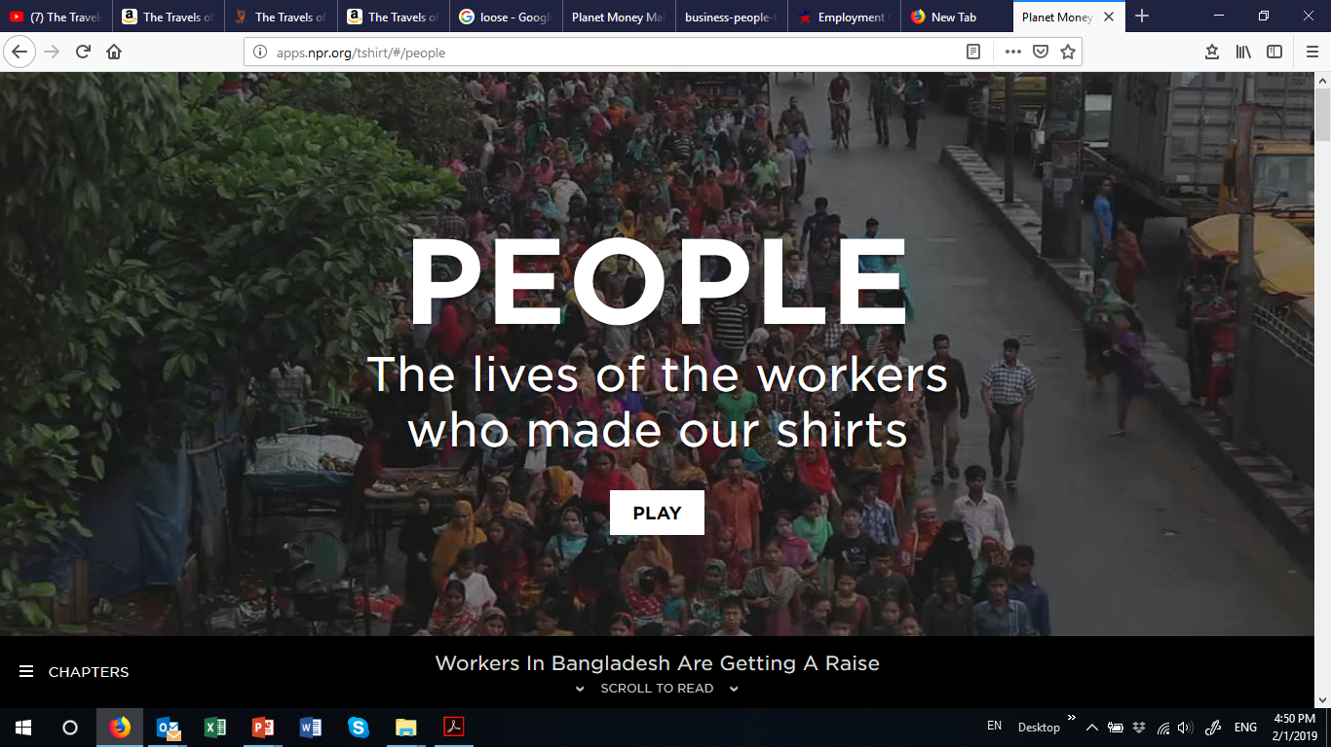
Global Value Chains: Mapping The Travels of a T-Shirt

Slide 8
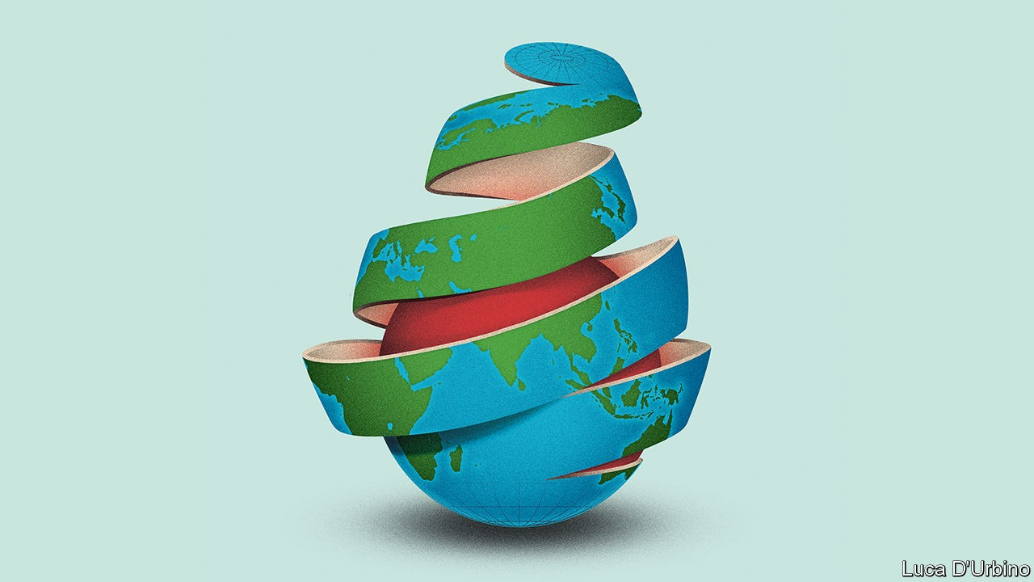
How do We Teach about Globalization Today?
Features of the global environment that were once stable and taken for granted have become dynamic and strategic
Is globalization unwinding?
How do we teach and learn about a dynamic and contested phenomenon?
Source: https://www.economist.com/leaders/2020/05/14/has-covid-19-killed-globalisation

Slide 9
A Volatile World: Living through a Historical Inflection Point
“The world is facing a Zeitenwende: an epochal tectonic shift. ... New powers have emerged or reemerged. ... In this new multipolar world, different countries and models of government are competing for power and influence.”
  Olaf Scholz, “The global Zeitenwende: How to avoid a new Cold War in a multipolar era,” Foreign Affairs, January/February 2023.
A Volatile World
Global Pandemic: 2020-2022
European War: Russo-Ukrainian War, 2022 – Present
Middle Eastern War: Israel, Hamas, Iran, 2023 – Present
Trade Wars: China-US Trade War, 2018-Present

Slide 10
21st Century Global Leadership in an Evolving Business Landscape
“I wish it need not have happened in my time,” said Frodo.
“So do I,” said Gandalf, “and so do all who live to see such times. But that is not for them to decide. All we have to decide is what to do with the time that is given us.”
Source: J.R.R. Tolkien (1954). The Fellowship of the Ring.

Slide 11
21st Century Global Leadership:
A Contested World Order
Contested World Order
- State conflict and rivalry (war)
- Great power politics (fear of war)
- Regional and global alliances
- Blurring lines between economic,
political and security domains
Political Economy of Trade
- Beyond free trade ideology
Trade wars, tariffs, sanctions,
industrial policies, national security
Political Economy of Production
Rethinking global value chains
Politics, risk, identify and resiliency
Resiliency Volatility Politics Ethics Risk Opportunity

Slide 12
Reexamining Assumptions about Free Trade and Open Borders
“Old assumptions can no longer be taken for granted, the world as we knew it is gone.”
British Prime Minister, Keir Starmer, April 2025
“For 40 years, we’ve had an economy that rewards people who ship American jobs overseas and raises taxes on American workers, and we’re flipping that on its head. We’re going to cut taxes for American workers and for American companies that build here. We’re going to make it harder to ship American jobs overseas.”
US Vice-President, JD Vance, April 2025
Source: 'The world as we knew it has gone' warns U.K. PM as tariffs threaten to upend global trade | Fortune Europe; CNN.com – Transcripts, April 3, 2025

Slide 13
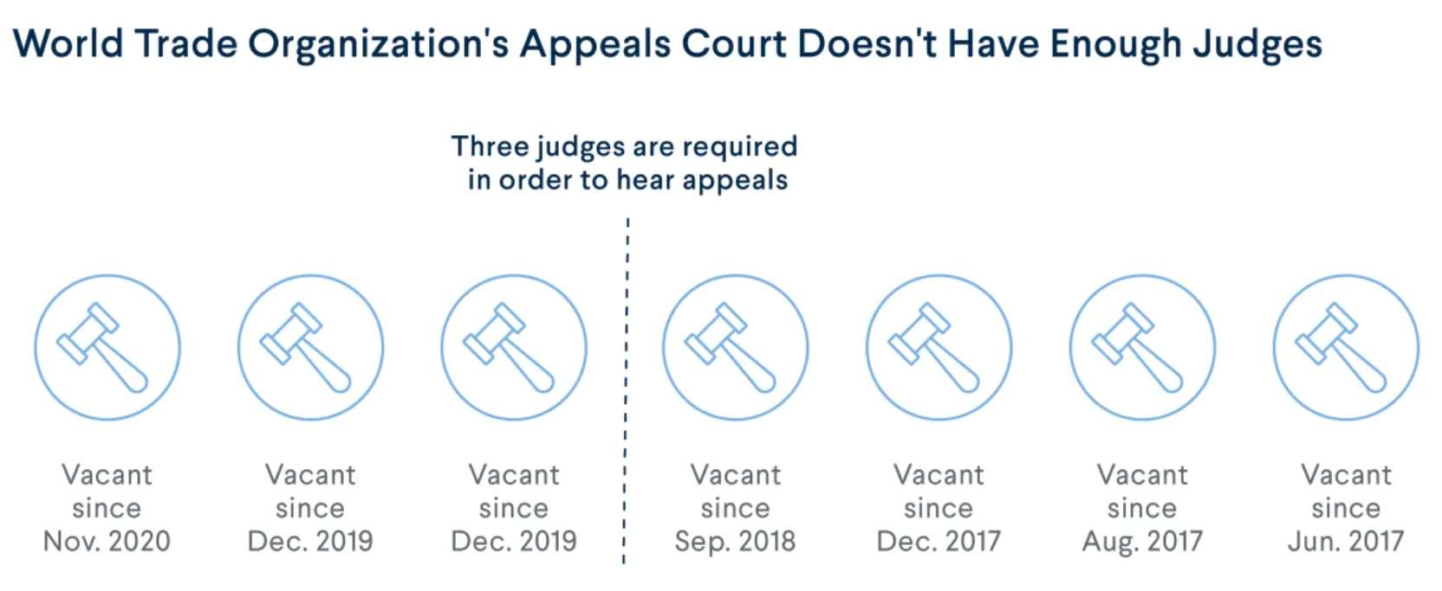
Reexamining Assumptions about Multilateral Cooperation
Source: Global Governance: Introduction - What Is the World Trade Organization? | CFR Education

Slide 14
Reexamining Assumptions about Peace and Stability
“Pandemic, war, and growing tensions between the two largest economies of the world—the US and China—have undoubtedly changed the playbook for global economic relations. The US calls for “friend-shoring,” the EU for “de-risking,” and China for “self-reliance.”
National security concerns are shaping economic policy worldwide.
Are we on the brink of Cold War II? If so, what would that mean for the global economy?”
  IMF First Managing Deputy Director Gita Gopinath,
  2024 World Congress of the International Economic Association
Source: Cold War II? Preserving Economic Cooperation Amid Geoeconomic Fragmentation (imf.org)

Slide 15
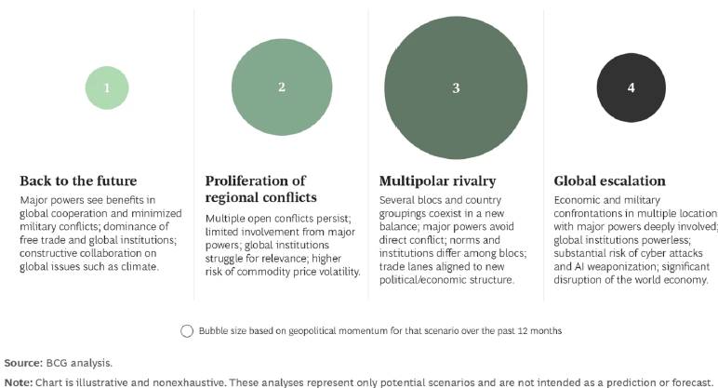
What Does the Future Hold?
Source: Gilbert, M. and Lang, N. 2024. Geopolitical Risk is Rising. Here’s How CEOs Can Prepare. BCG Consulting, May 21

Slide 16
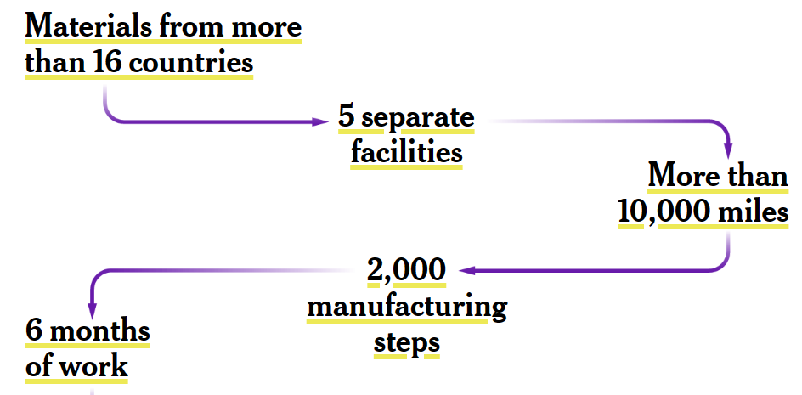
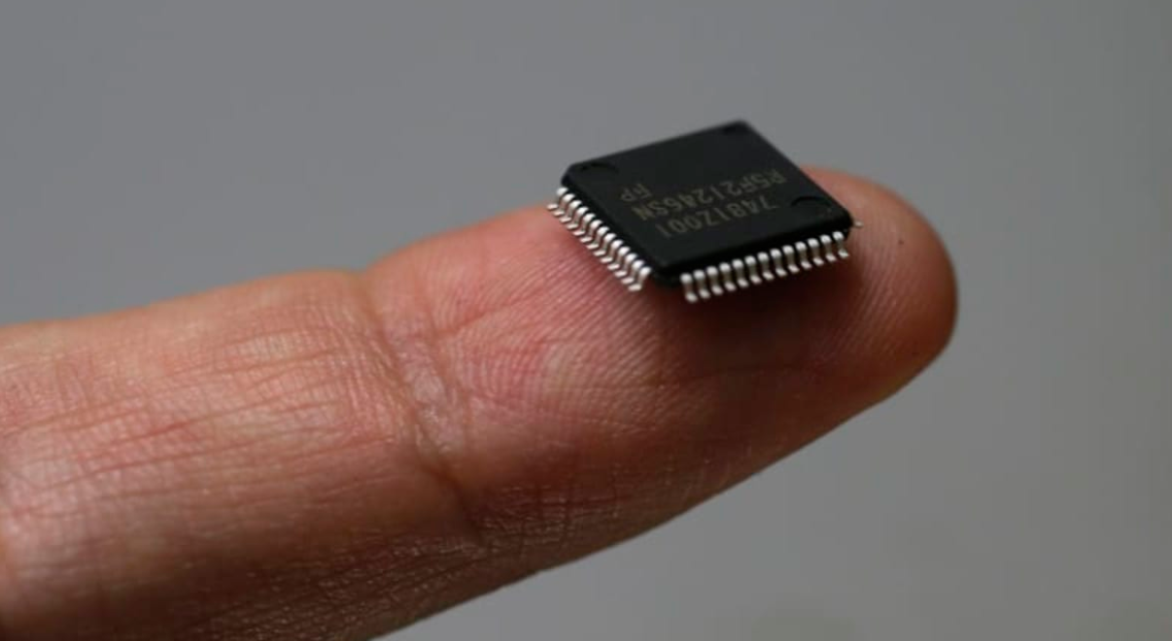
Case: The Global Semiconductor Chip Industry
Source: The Global Effort to Make an American Microchip - The New York Times (nytimes.com)

Slide 17
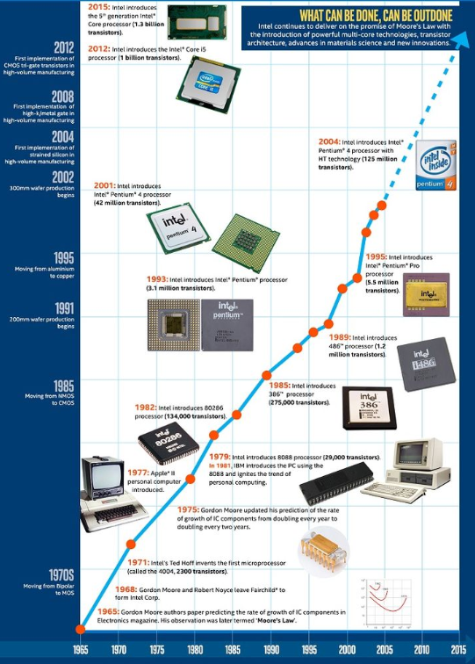
The Design of Semiconductor Chips
Moore’s Law predicted in 1965 the number of transistors in a microchip would double about every two years, whereas its cost would be halved over the same time frame.

Slide 18
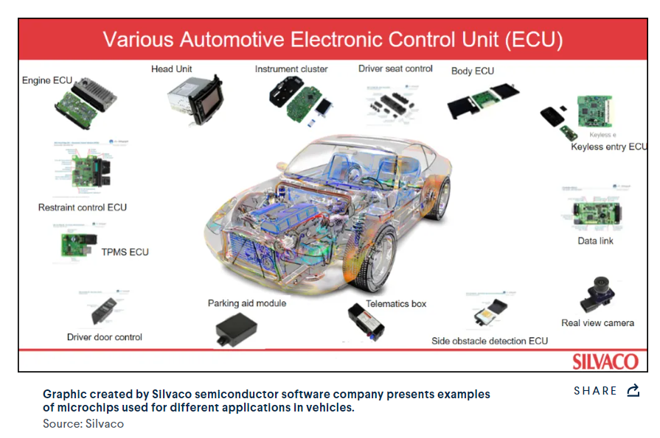
Average Car Uses Over 100 Chips
Source: Design IP for Automotive SoCs: Trends and Solutions - Silvaco

Slide 19
The Benefits of Comparative Advantage and Free Trade
“Semiconductor-manufacturing plants, known as fabs, are the most expensive factories in the world, conducting the most complex manufacturing ever accomplished, at a scale of production never before achieved with any other device.
The wider chip industry, meanwhile, is a web of mutual interdependence, spread all over the planet in highly specialized regions and companies, its feats made possible by supply chains of exceptional length and complexity — a poster child, in other words, for globalization.
“It’s hard to imagine how the capabilities they’ve reached would be possible without access to the smartest minds in the world all working together,” Miller says.”
Source: ‘An Act of War’: Inside America’s Silicon Blockade Against China - The New York Times

Slide 20
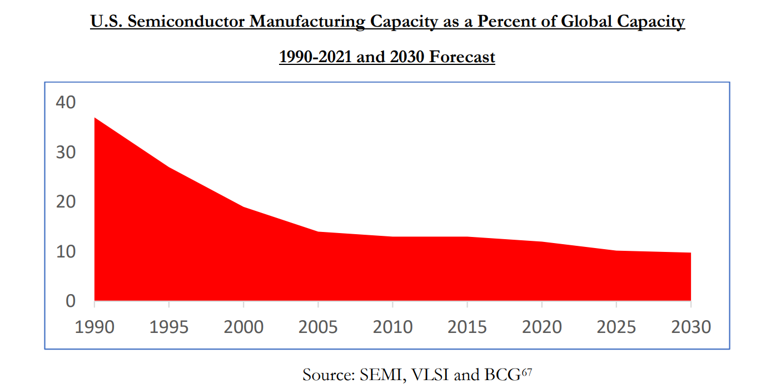
Global Value Chains (as Designed) Led to Offshoring of US Manufacturing Capacity
Source: 100-day-supply-chain-review-report.pdf (whitehouse.gov)

Slide 21
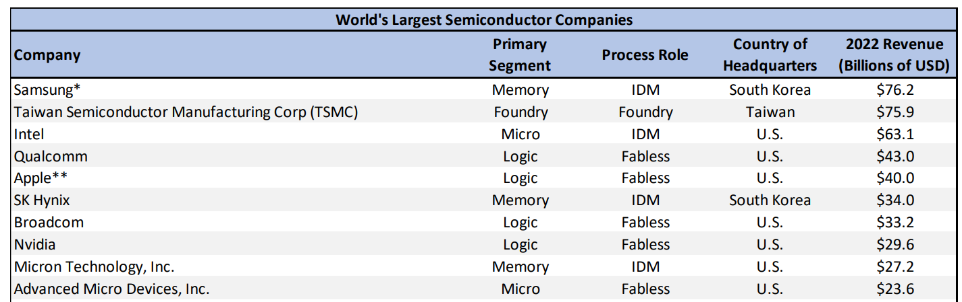
Offshore Outsourcing in Value Chain Emergence
Company Types
Fabless (multinational lead firm) – organizations that outsource all or nearly all of their manufacturing processes;
Foundry (contract manufacturer) – organizations that manufacture exclusively or nearly exclusively for other companies;
Integrated Device Manufacturer (IDM) – organizations that carry out most of their own design and manufacturing;
SOURCE: DEPARTMENT OF COMMERCE. 2023. ASSESSMENT OF THE STATUS OF THE MICROELECTRONICS INDUSTRIAL BASE IN THE UNITED STATES, A STUDY CONDUCTED UNDER SECTION 705 OF THE DEFENSE PRODUCTION ACT

Slide 22
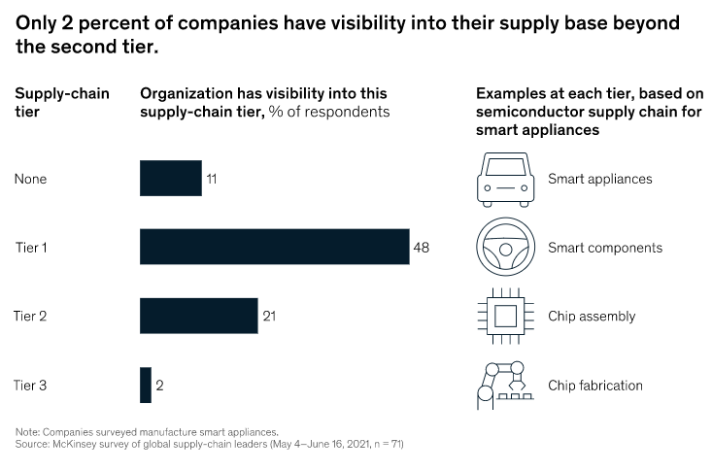
Multinational Lead Firms (by Design) Did Not Know Where Chips Were Fabricated
Source: https://www.mckinsey.com/business-functions/operations/our-insights/how-covid-19-is-reshaping-supply-chains

Slide 23
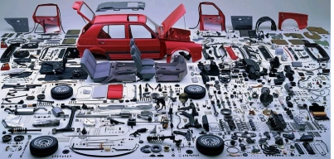
Lessons from the Pandemic: Chokepoints in Global Value Chains
“It takes 2,500 parts to build a car, but only one not to.”
  Peter Hasenkam, former head of Tesla supply chain strategy
Source:https://hbr.org/2022/05/the-semiconductor-crisis-should-change-your-long-term-supply-chain-strategy;
Picture Source: https://www.amatechinc.com/resources/blog/returnable-packaging/tier-1-2-3-automotive-industry-supply-chain-explained

Slide 24
Lessons from the Pandemic: Chokepoints and Resiliency
A chokepoint (or bottleneck) in a global value chain is a point of congestion or obstruction where a single point of failure can lead to slowdown or collapse of the entire chain
  As discovered during the COVID pandemic, the production of semiconductor chips represents a chokepoint for the automobile value chain because a car cannot be built without them
Resiliency refers to an organization’s ability to recover from unexpected downturns, such as the breakdown of a chokepoint
Source: https://www.ascm.org/ascm-insights/5-supply-chain-chokepoints-you-need-to-fix

Slide 25
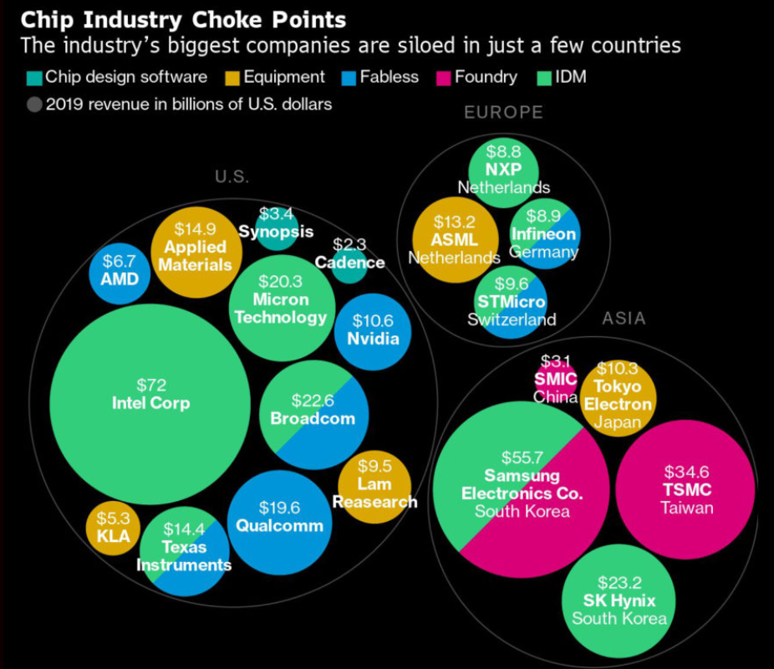
Comparative Advantage: Foundries Primarily Location in Taiwan
Source: https://www.supplychainbrain.com/articles/32482-the-world-is-dangerously-dependent-on-taiwan-for-semiconductors

Slide 26
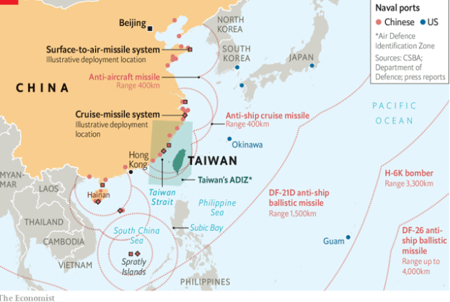

Chokepoints: From Pandemic to Great Power Politics

Slide 27
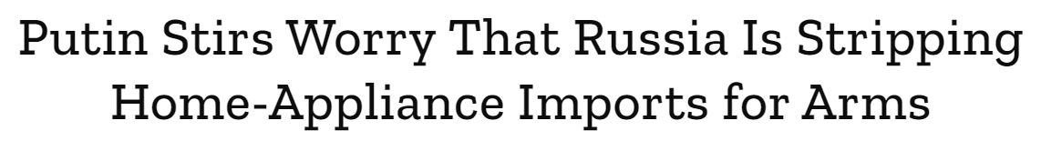
Semiconductors as Dual Use Technology
“A sudden and surprising spike in European exports of washing machines, refrigerators and even electric breast pumps to Russia’s neighbors is raising concerns among officials the trade boom may be helping Vladimir Putin’s war machine in Ukraine.
Armenia imported more washing machines from the European Union during the first eight months of the year than the past two years combined, according to data compiled by Bloomberg from the EU’s Eurostat database. Kazakhstan imported $21.4 million worth of European refrigerators through August, more than triple the amount for the same period last year.”
Source: Time, October 29, 2022

Slide 28
U.S.-Taiwan Relations: Rand Policy Scenario
The Rand corporation played a policy scenario game with group of military and corporate leaders about how to respond to the Chinese invasion of Taiwan and the take-over of Taiwanese semi-conductor industry
The choices in one scenario available to the United States and its allies were:
  Accept the People Republic of China’s demands to work with their newly-captured semiconductor firms and effectively abandon the autonomy of Taiwan;
  Refuse China’s demands and try to build alternatives to reliance on Taiwanese semiconductors, requiring many years of diminished economic output;
  Go to war to protect Taiwan and coerce the PRC to stop its quest for unification, which would also be expected to lead to global economic disruption.
Martin, Bradley et al. (2023). Supply Chain Interdependence and Geopolitical Vulnerability: The Case of Taiwan and High-End Semiconductors. Santa Monica, CA: RAND Corporation. https://www.rand.org/pubs/research_reports/RRA2354-1.html

Slide 29
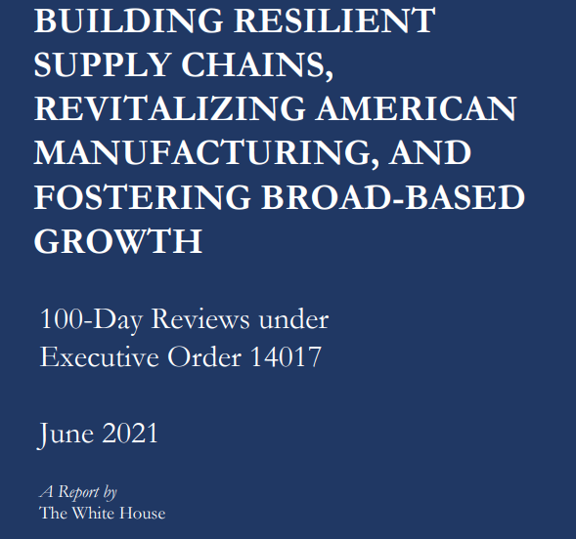
Resilient Value Chains: New Economic and Security Priority
“More secure and resilient supply chains are essential for our national security, our economic security, and our technological leadership.
[T]he typical semiconductor production process includes multiple countries, and the products may cross international borders 70 times
The contract foundry market is dominated by Taiwan-based companies, with TSMC alone accounting for 53 percent of the market share of the foundry market. In total, Taiwan-based companies account for 63 percent of the market share.”

Slide 30
Semiconductors as 21st Century Horseshoe Nails
“Remember that old proverb: “For want of a nail, the shoe was lost. For want of a shoe, the horse was lost.”
Even small failures at one point in the supply chain can cause outside impacts further up the chain.
Recently, we’ve seen how a shortage of computer chips — computer chips like the one I have here — you can hardly see it I imagine; it’s called a “semiconductor” — has caused delays in production of automobiles. A 21st century horseshoe nail.”
  President Biden, Remarks at Executive Order on Protecting US Supply Chains, February 2021
.
“For want of a nail, the shoe was lost.
For want of a shoe, the horse was lost.
For want of a horse, the rider was lost.
For want of a rider, the battle was lost.
For want of a battle, the kingdom was lost,
And all for the want of a horseshoe nail.”
Poor Richard's Almanack, 1758
Source: Remarks by President Biden at Signing of an Executive Order on Supply Chains | The White House

Slide 31
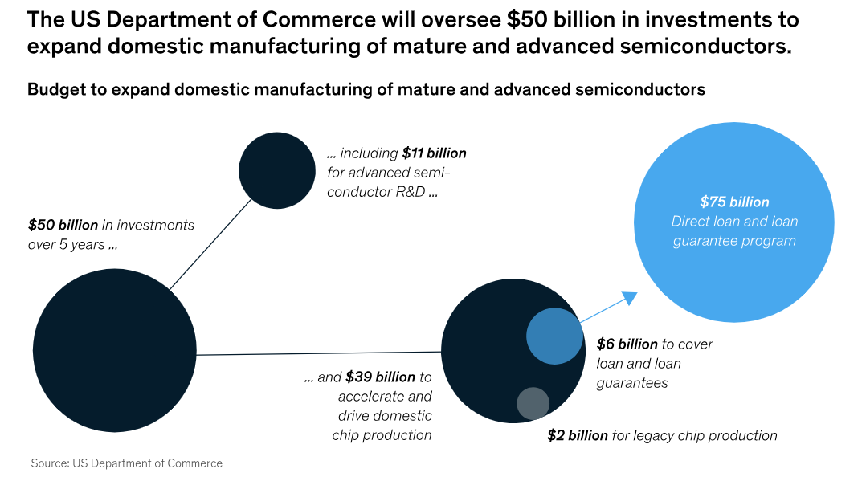
Industrial Policy: US Chips and Science Act
Source: 2022, The CHIPS and Science Act | Public Sector | McKinsey & Company

Slide 32
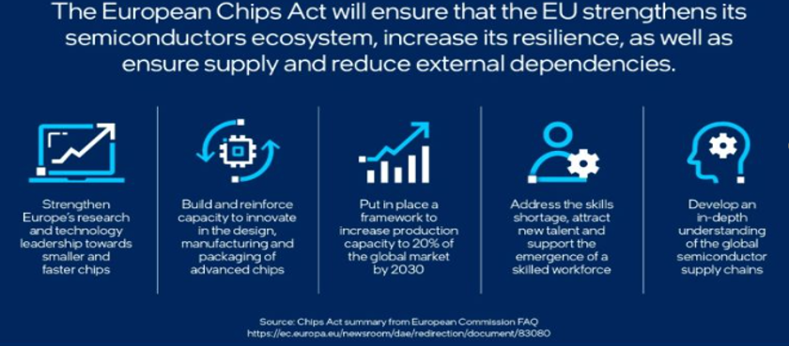
Industrial Policy: European Chips Act

Slide 33
Strings Attached: Future Investment Guardrails in US Policy
“Prohibits recipients of CHIPS incentives funds from using the funds to construct, modify, or improve a semiconductor facility outside of the United States;
Restricts recipients of CHIPS incentives funds from investing in most semiconductor manufacturing in foreign countries of concern [e.g., China] for 10 years after the date of award; and,
Limits recipients of CHIPS incentives funds from engaging in certain joint research or technology licensing efforts with a foreign entity of concern that relates to a technology or product that raises national security concerns.
If these guardrails are violated, the Department can claw back the entire federal financial assistance award.”
Source: Biden-Harris Administration Announces Final National Security Guardrails for CHIPS for America Incentives Program | U.S. Department of Commerce, September 2023

Slide 34
Do Companies Need to Choose Sides?
“Taiwan’s TSMC is currently bringing online a 28-nanometer wafer fabrication plant in Nanjing, China, characterizing it as “the sweet spot for our embedded memory applications.” Total investment for this project is reportedly $2.9 billion.
However, Taiwanese observers view the proposed U.S. guardrails as potentially suspend[ing] TSMC’s Nanjing expansion program:
  “It is expected that TSMC will slow down its investment in [China] and focus on building production capacity in the U.S., Japan and even Europe in the future, with Taiwan remaining a production hub.”
Source: “Guardrails” on CHIPS Act Funding to Restrict Investments in China May Restrict Participation in CHIPS Act Incentives | Perspectives on Innovation | CSIS

Slide 35
From Industrial Policies to Tariffs
“TSMC, I gave them no money ... all I did was say, if you don't build your plant here, you're going to pay a big tax.”
-- U.S. President Donald Trump, reporting on what he told the Taiwan Semi-Conductor Manufacturing Corporation (TSMC) to produce in the United States, April 2025
Source: Trump says he told TSMC it would pay 100% tax if it doesn't build in US | Reuters, April 8, 2025

Slide 36
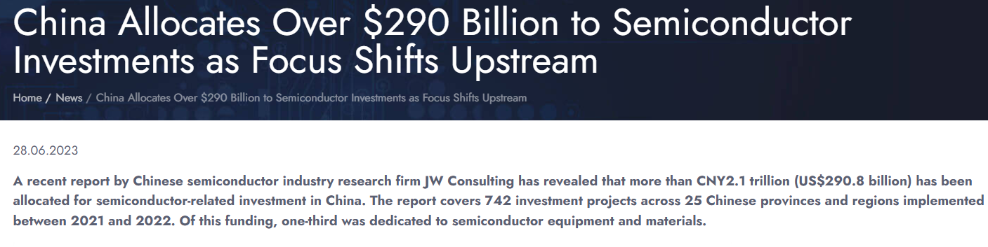
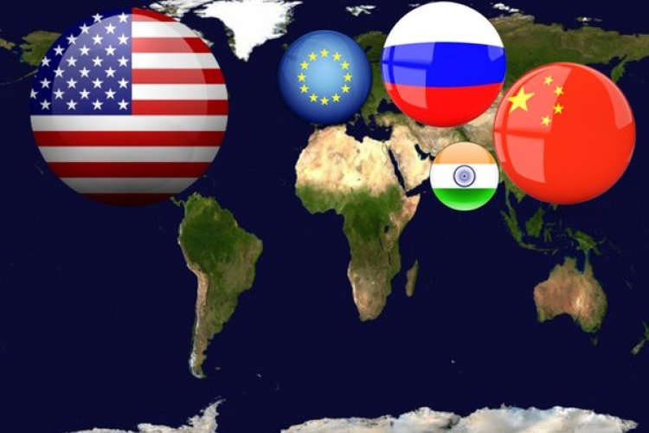
Multipolar World Order: Chinese Investment in Semiconductors

Slide 37
The Emergence of Techno-Nationalism
Techno-Nationalism: The belief that a nation's technological development and leadership in innovation are essential to national security and geopolitical power, such that technological development should be protected or directed by the state.
Source: The Unwinding of Global Tech Supply Chains | BCG

Slide 38
Beyond Free Trade: “Small Yard, Big Fence”
“Many of you have heard the term “small yard, high fence” when it comes to protecting critical technologies. The concept has been cited at think tanks, universities, and conferences for years. We are now implementing it.
Chokepoints for foundational technologies have to be inside that yard, and the fence has to be high—because our strategic competitors should not be able to exploit American and allied technologies to undermine American and allied security.”
  Former U.S. National Security Advisor Jack Sullivan (2023)
Source: Remarks by National Security Advisor Jake Sullivan on the Biden-Harris Administration’s National Security Strategy | The White House

Slide 39
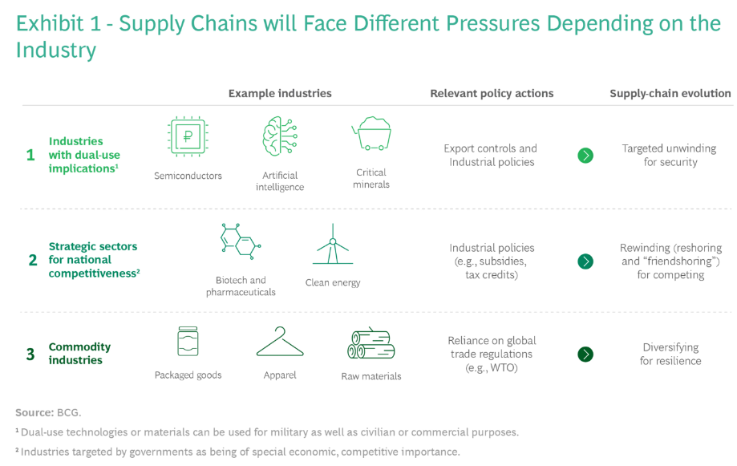
Future of Trade: Techno-Nationalism
Source: The Unwinding of Global Tech Supply Chains | BCG

Slide 40
Blurring Boundaries between
Economics and Security: Friendshoring
“We cannot allow countries to use their market position in key raw materials, technologies, or products to have the power to disrupt our economy or exercise unwanted geopolitical leverage. So let’s build on and deepen economic integration and the efficiencies it brings on terms that work better for American workers. And let’s do it with the countries we know we can count on.
Favoring the friend-shoring of supply chains to a large number of trusted countries, so we can continue to securely extend market access, will lower the risks to our economy as well as to our trusted trade partners.”
  Janet Yellen, US Treasury Secretary, April 2022
Source: https://www.atlanticcouncil.org/news/transcripts/transcript-us-treasury-secretary-janet-yellen-on-the-next-steps-for-russia-sanctions-and-friend-shoring-supply-chains/

Slide 41
Beyond Free Trade: The New Resiliency Imperative
“The manager of the global factory has to ask two very straightforward questions of each activity in the global network. Where should this activity be located? How should this activity be controlled?”
  Buckley (2014)
Source: Buckley, P. J. (2014). International integration and coordination in the global factory. The multinational enterprise and the emergence of the global factory, 3-19.

Slide 42
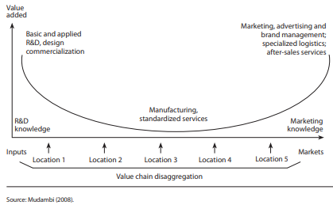
Old Assumptions: The Benefits of Global Specialization and Trade
Offshore Outsourcing allows firms to specialize in those activities in which it is best and trade with firms who specialize in other parts of the global value chain, thus creating long-lasting benefits to firm specialization and free trade
Source: Graph from Van Assche, A. (2017). Global value chains and the rise of a supply chain mindset. Redesigning Canadian trade policies for new global realities, 183-208
Notes:
Arbitrage can take place in labor cost (such as locating garment assembly in low-cost emerging economies), but also for high value activities such as Huawei locating R&D centers in Europe to gain access to knowledge capabilities unavailable in China.

Slide 43
Orchestrating Global Value Chains: Location and Ownership
Outsourcing
Domestic supplier performs task or activity
Offshore outsourcing
Overseas supplier performs task or activity
Contract to Suppliers
Ownership
Domestic operations
Lead firm performs task or activity itself
Offshore operations
Lead firm’s overseas subsidiary performs task or activity
The is foreign direct investment
Self-Ownership
Domestic
International
Location

Slide 44
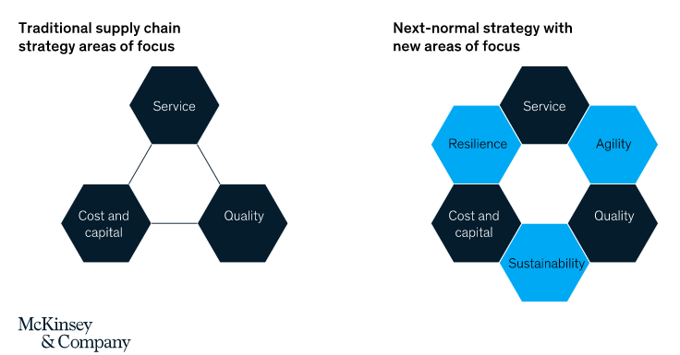
Orchestrating Global Value Chains:
The New Resiliency Imperative
Source: https://www.mckinsey.com/business-functions/operations/our-insights/future-proofing-the-supply-chain

Slide 45
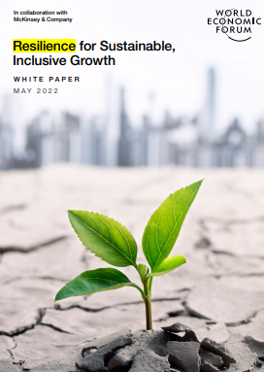
Global Leadership in a Disruptive World: The “Resilience Muscle”
“In a world of continuous, overlapping disruptions, organizations need to build and manage resilience to secure a sustainable, inclusive future for all.
Ample investment and new capabilities are needed, to build a “resilience muscle.”
Resilience should be seen as the ability to deal with adversity, withstand shocks and continuously adapt and accelerate as disruptions and crises arise over time.
The focus must be on flexibility and prevention, enabling faster adaptation to disruptions and changes in the environment.”

Slide 46
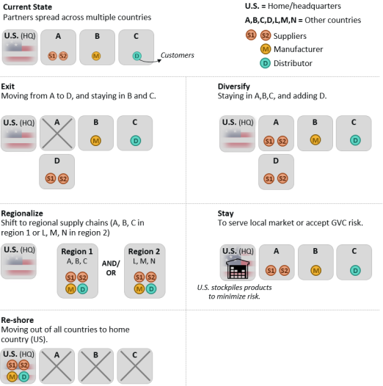
Beyond Free Trade : Offshoring, Reshoring, Friendshoring, Nearshoring
Friendshoring
Shift to friendly countries
Friends
Not
Friends
Source: Global Value Chains: Overviews and Issues for Congress. (2020). Congressional Research Service

Slide 47
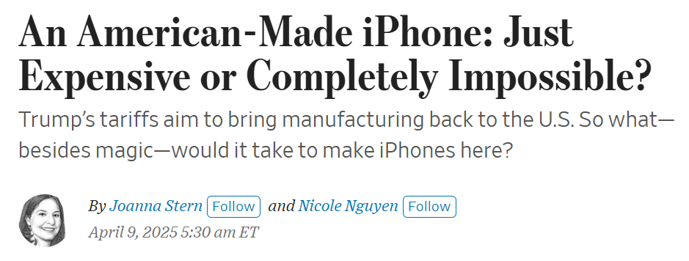
How Difficult is it to Reshore?
So we assembled a panel of manufacturing and technology experts to find out how hard it would be for Apple to bring iPhone production to the U.S. The short answer? It’s easier to teach a bald eagle to use a screwdriver.
Source: A Made-in-America iPhone? Here’s What Apple Would Need to Do - WSJ

Slide 48
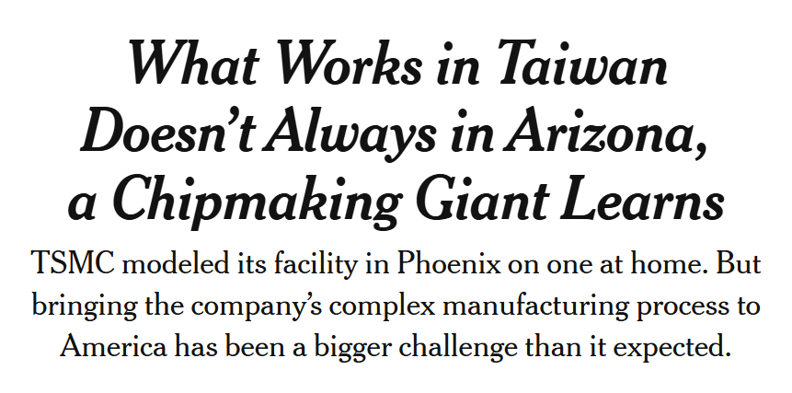
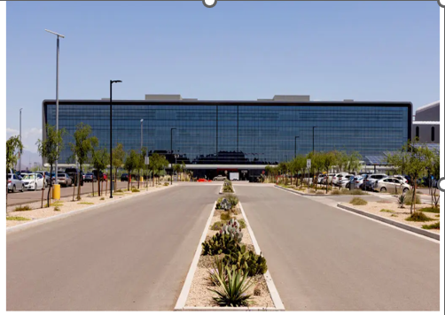
TSMC has committed $65 billion to the project, and in April, the Biden administration announced that the company would receive a $6.6 billion grant funded by the CHIPS and Science Act.
Source: Why TSMC Has Struggled to Manufacture Chips in Arizona - The New York Times (nytimes.com)

Slide 49
“Oh, my gosh, people work hard”
“12 TSMC employees, including executives, said culture clashes between Taiwanese managers and American workers had led to frustration on both sides. TSMC is known for its rigorous working conditions. It’s not uncommon for people to be called into work for emergencies in the middle of the night.
About half of the 2,200 workers at TSMC in Phoenix were brought in from Taiwan, 7,200 miles away.
Jefferson Patz, an engineer fresh off a master’s degree from the University of California, San Diego, went to Tainan in 2021 for 18 months of training shortly after he joined the company.
“Oh, my gosh, people work hard,” Mr. Patz said.”
Source: Why TSMC Has Struggled to Manufacture Chips in Arizona - The New York Times (nytimes.com)

Slide 50
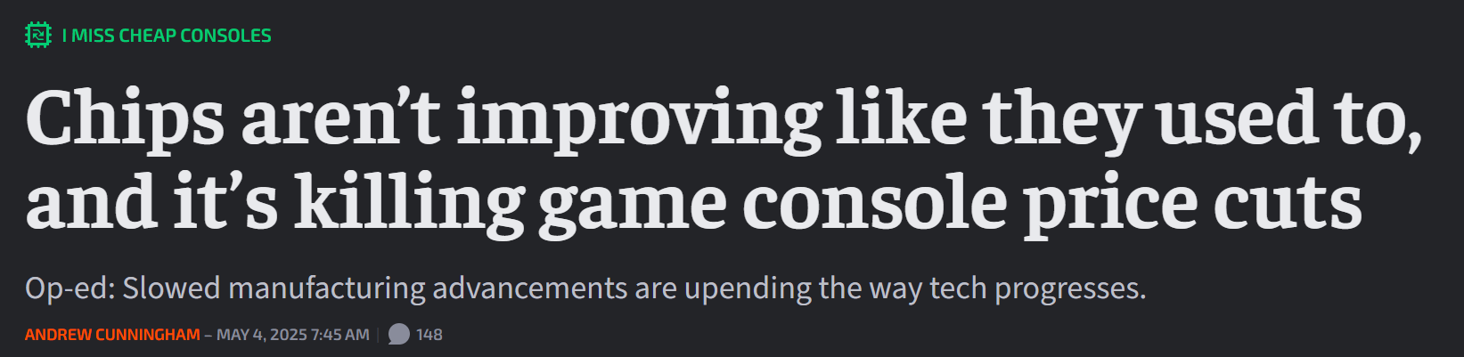
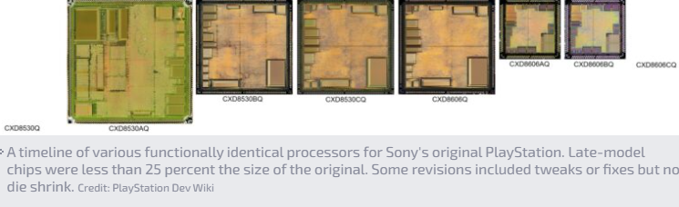
The End of Moore’s Law?
Source: Chips aren’t improving like they used to, and it’s killing game console price cuts - Ars Technica

Slide 51
Enduring Dilemma: Balancing Global Integration and National Independence
Globalization Cycles
National Independence
Global Integration
“For almost 200 years, globalization has been seen as a positive development, albeit with costs and benefits, and as progress and modernization, a broadening of humanity’s scope from the local and parochial to the cosmopolitan and international. That changed dramatically with the Great Recession, the waves of migration of the last decade, and the global Coronavirus (COVID-19) pandemic of 2020. For many, globalization now connotes economic dislocation, increasing inequality, unwanted immigration, and a vehicle for disease. .. A more positive view of globalization will require restoring the balance between independence and independence.”
-- Stephen Kobrin. (2020). When globalization becomes a thing that goes bump in the night. Journal of International Business

Slide 52
21st Century Global Leadership:
A Contested World Order
Contested World Order
- State conflict and rivalry (war)
- Great power politics (fear of war)
- Regional and global alliances
- Blurring lines between economic,
political and security domains
Political Economy of Trade
- Beyond free trade ideology
Trade wars, tariffs, sanctions,
industrial policies, national security
Political Economy of Production
Rethinking global value chains
Politics, risk, identify and resiliency
Resiliency Volatility Politics Ethics Risk Opportunity

Slide 53
21st Century Global Leadership
Transnational Mindset – A transnational mindset is required to understand the distributed sets of actors, activities and standards situated across multiple locations that are driving global uncertainty and change.
Interdisciplinary Problem Solving -- Global disruption raises issues for business, social, political and economic leaders that extend beyond traditional functional knowledge or disciplinary expertise
Agile and Resilient Decision-Making – Flexible decision-making habits that respond quickly to change, and recover quickly from inevitable mistakes, are needed to navigate an uncertain future.

Slide 54
Can a Firm or Individual Plan to Be Resilient to Change?
Resiliency: Ability to recover from unexpected and stressful events.
  I tend to bounce back quickly after hard times
  I have a hard time making it through stressful events.
  It does not take me long to recover from a stressful event.
  It is hard for me to snap back when something bad happens
  I usually come through difficult times with little trouble.
  I tend to take a long time to get over set-backs in my life
Source: Brief Resilience Scale (BRS)

Slide 55

Self-Development and the Ability to Take Feedback and Learn
Self-Development: Competency to continually learn and develop new skills and to manage one’s own development process.
  Continually develops new skills and expertise
  Seeks opportunities to stretch and grow
  Understands one’s own strengths and weaknesses
  Accepts constructive feedback
  Positively incorporates constructive feedback to change behavior

Slide 56
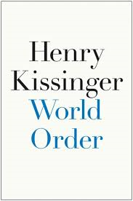
How Much Do we Need to Teach about World Order?
“World order describes the concept held by a region or civilization about the nature of just arrangements and the distribution of power thought to be applicable to the entire world.
[World order] bases itself on two components: a set of commonly accepted rules that define the limits of permissible action and a balance of power that enforces restraint when rules break down, preventing one political unit from subjugating all others.”
  Henry Kissinger, World Order (2014)

Slide 57
Future World Order May Manifest in Many Directions
A two-pole order may include a great power struggle between China and the United States
A three-pole order may include the European Union, China, and the United States
There are many permutations of 3 or more country blocs and alliances

Slide 58

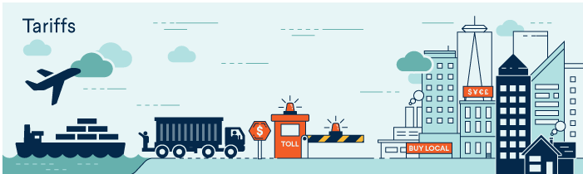
Resources: World 101 Council on Foreign Relations
Source: https://world101.cfr.org/global-era-issues/trade/what-gets-way-free-trade

